Slide 1
AASD4011: Mathematical Concepts for Deep Learning
Training and Hyperparameters Tuning Techniques
Based on Geron Chapter 11

Slide 2
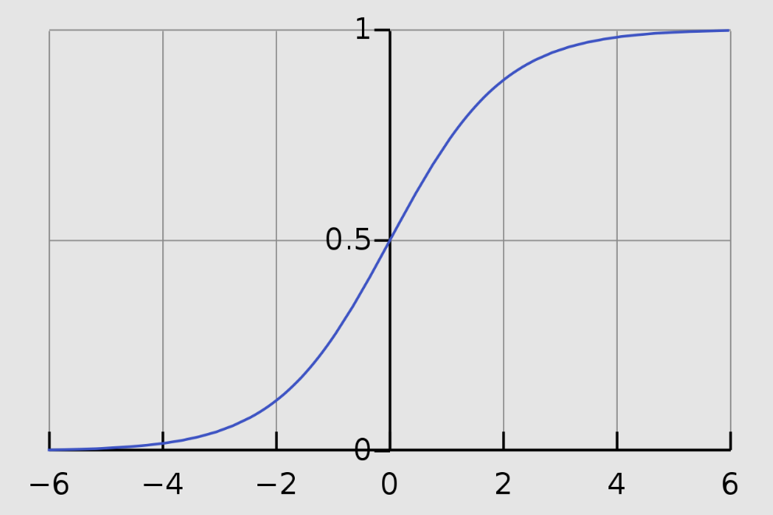
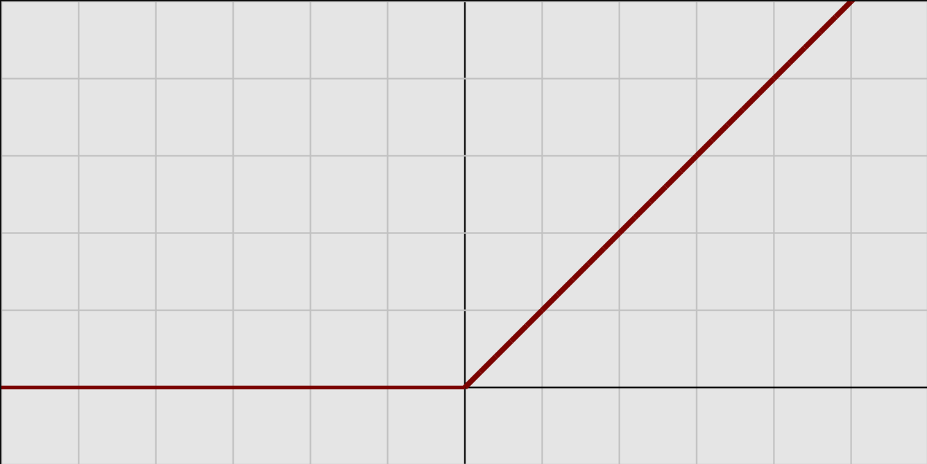
The Vanishing and Exploding Gradient and Activation Functions
Sigmoid
ReLU
Compare the gradient of the two activation functions.
What is it for large values of input z (positive and negative)?
Wikipedia
Wikipedia

Slide 3
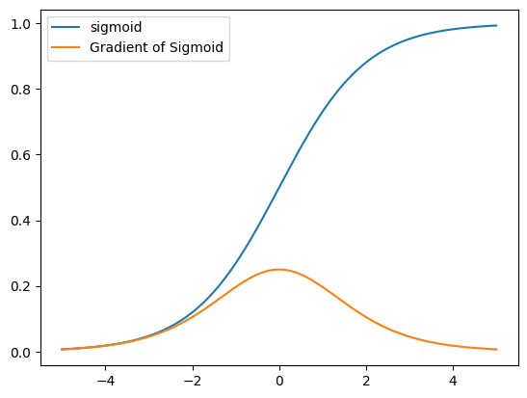
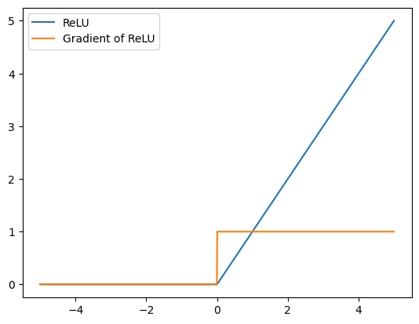
The Gradient of a Sigmoid vs. a ReLU

Slide 4
In NN, The Impact of a vanishing gradient of a single activation function such as a sigmoid is compounded:
https://www.mathworks.com/help/deeplearning/ug/detect-vanishing-gradients-in-deep-neural-networks.html

Slide 5
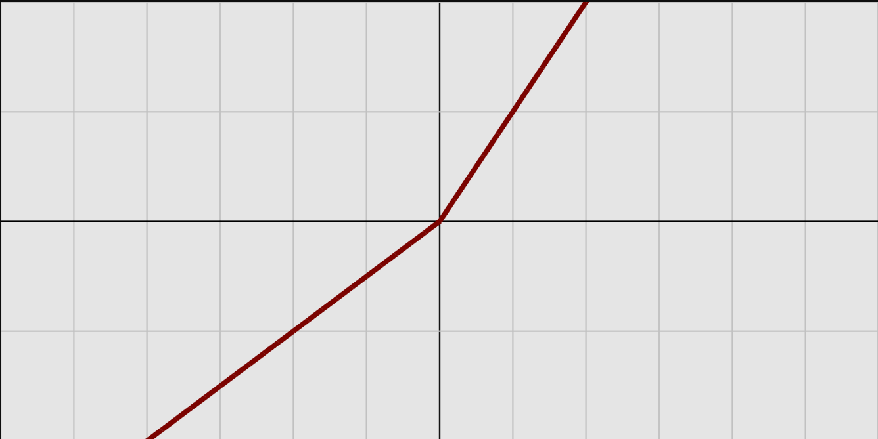
Activation Functions
ReLU
Rectified Linear Unit and Leaky ReLU
Wikipedia

Slide 6

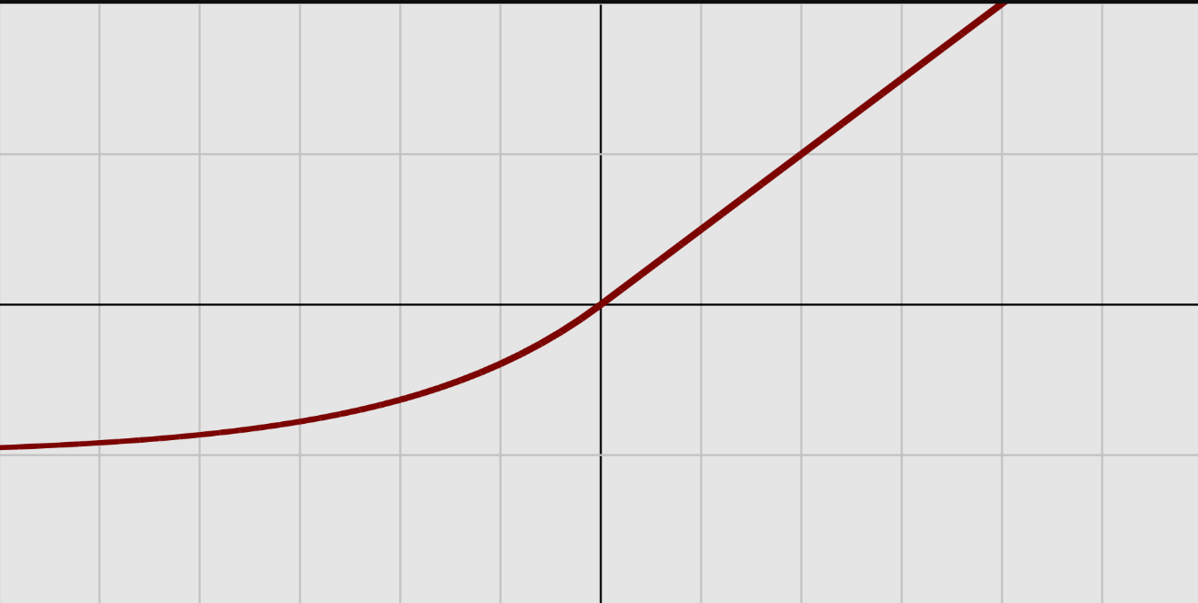
Activation Functions
Exponential Linear Unit (ELU; Tensorflow, PyTorch)
Scaled Exponential Linear Unit (SELU; Tensorflow, PyTorch)
Wikipedia

Slide 7

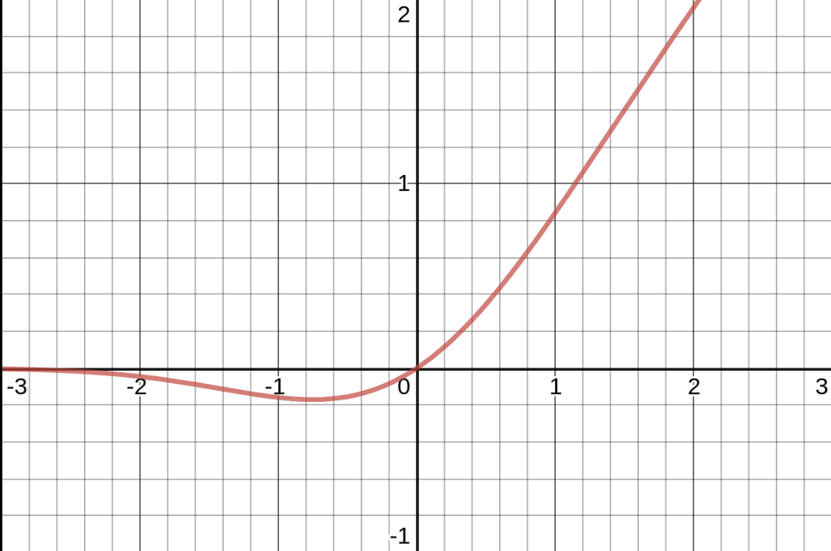
Activation Functions
Gaussian Error Linear Unit (GELU)
Tensorflow
PyTorch
Φ is the standard Gaussian cumulative distribution function (CDF): Φ(z) corresponds to the probability that a value sampled randomly from a normal distribution of mean 0 and variance 1 is lower than z.
In practice, it often outperforms every other activation function discussed so far. However, it is a bit more computationally intensive, and the performance boost
it provides is not always sufficient to justify the extra cost (Geron, p.365)
Wikipedia

Slide 8
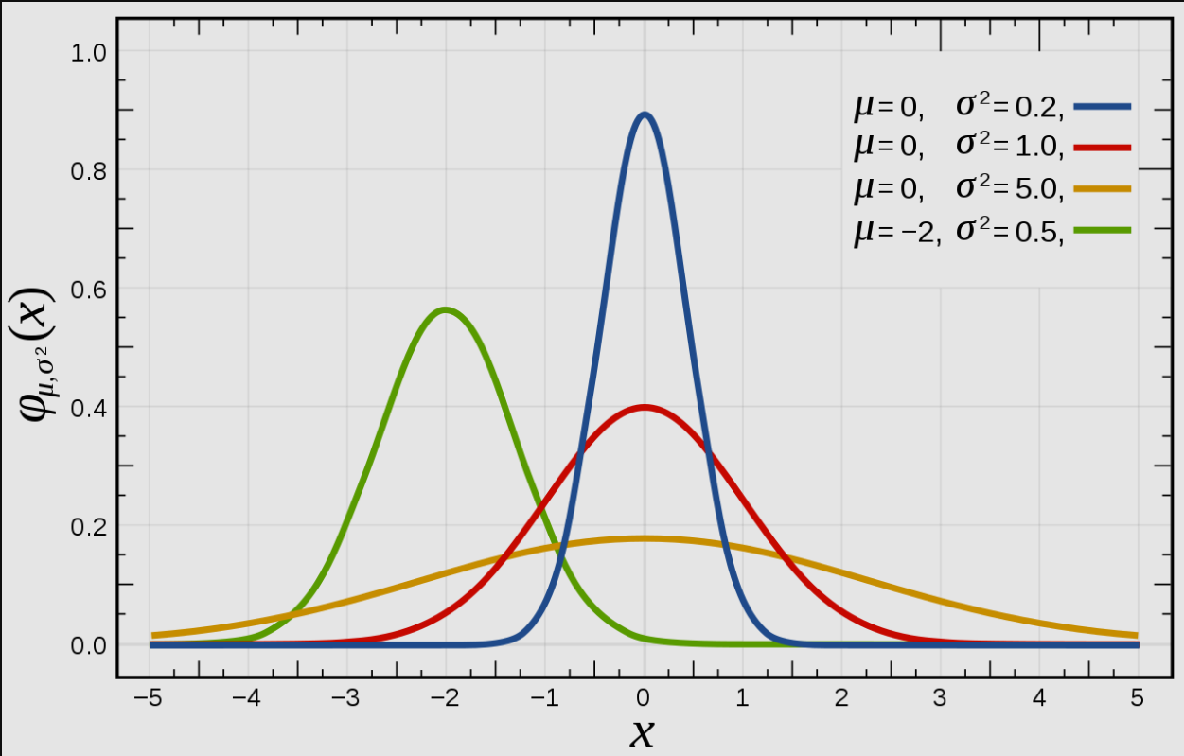
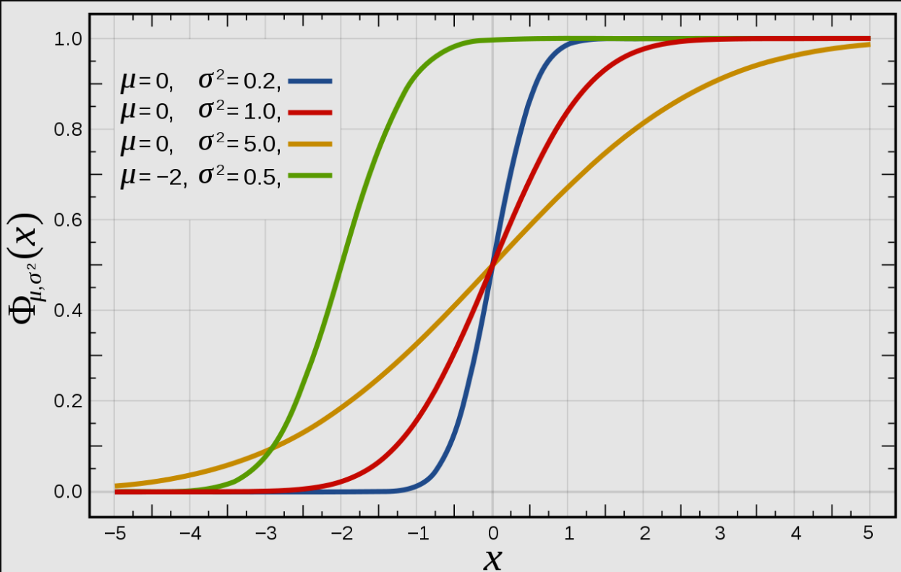
Wikipedia
Wikipedia
https://en.wikipedia.org/wiki/Normal_distribution
https://en.wikipedia.org/wiki/Cumulative_distribution_function

Slide 9
Activation Functions
ReLU is a good default for simple tasks
GELU is a better default for more complex tasks
For low runtime latency, consider a leaky ReLU

Slide 10
Initialization
Activation | Activation Function | Variance of Normal Dist
Glorot (Xavier) | Passthrough, tanh, sigmoid, softmax | 1/fan_avg
He | ReLU, Leaky RELU, ELU, GELU | 2/fan_avg
Lecun | SELU | 1/fan_in
Fan_in – the number of inputs to the layer
Fan_out – the number of outputs of the layer
Fan_avg = (Fan_in + Fan_out)/2
By default, Keras uses Glorot (Xavier) initialization with a uniform distribution.

